Slide 1
TRUAC Meeting #7
Renee Brooke, Planning Manager
Pauline Hardie, Senior Planner
October 18, 2023

Slide 2

Agenda
Roll Call
Declaration of Actual or Potential Conflicts
Mitigation Options (On-Site Tree Replacement and Fee In-Lieu of Preservation)
Minimum/Maximum Lot Sizes to Consider for Mitigation Options
Next Steps

Slide 3
City Council Check-in Update & Scope
Provide consistency between BMC Chapter 16.10, Clearing, Grading, and Erosion Control on Construction Sites, BDC Chapter 3.2, Landscaping, Street Trees, Fences and Walls and City of Bend Standards and Specifications Chapter 12, Landscape Architecture and Irrigation Systems
Provide clear and objective tree preservation standards for the development of housing, including needed housing, and include an optional discretionary process for applicants for development;
Consider preservation standards for larger trees similar to the Southeast Area Plan; and
Consider alternatives to preserving trees, including tree replacement and a fee-in-lieu of preservation for the purpose of developing and protecting the City’s urban tree canopy.
Identify tree inventory programs to support preserving and expanding Bend’s urban tree canopy.

Slide 4
Recommendations to Date

Slide 5
Tree Preservation Flow Chart
Preserve Priority Trees? (20”+)
Yes
Preserve % of ALL Trees? (6” +)
No
No (or not completely)
Yes
Mitigate On-Site?
Yes
No (or not completely)
Pay Fee In-Lieu of Preservation
Done
Done
Done
20 %
25%
Ratio TBD
Can be a combination of these three options

Slide 6
# of Trees 20” or Larger (Priority Trees)
 | Sky Vista Single-Unit 9.13 Acres | Poplar Cottages 0.54 Acres | Century Mixed-Use 1.50 Acres | Veridian Multi-Unit 2.81 Acres | Caraway Master Plan (Phase 1) 16.81 Acres | Parkside Place Master Plan 37.10 Acres | Bri Multi-Unit 2.23 Acres | Bulletin Multi-Unit 1.57 Acres | Round up | Round down
Trees 20" or Larger
Actual Trees 20”+ | 30 | 12 | 14 | 14 | 15 | 39 | 5 | 6 | 135 | 135
Actual Preservation | 2 | 1 | 0 | 3 | 6 | 11 | 5 | 5 | 33 | 33
20% | 6 | 2.4 | 2.8 | 2.8 | 3 | 7.8 | 1 | 1.2 | 29 | 24
25% | 7.5 | 3 | 3.5 | 3.5* | 3.75 | 9.75 | 1.25 | 1.5 | 37 | 30
30% | 9 | 3.6 | 4.2 | 4.2 | 4.5 | 11.7* | 1.5 | 1.8 | 44 | 37
* save one more 20” tree or round down
Notes:
When rounded up - Actual preservation provides more than 20% and less than 25% and 30%
When rounded down - Actual preservation provides more than 20% and 25% but less than 30%

Slide 7
DBH (Regulated and Priority)
 | Sky Vista Single-Unit 9.13 Acres | Poplar Cottages 0.54 Acres | Century Mixed-Use 1.50 Acres | Veridian Multi-Unit 2.81 Acres | Caraway Master Plan (Phase 1) 16.81 Acres | Parkside Place Master Plan 37.10 Acres | Bri Multi-Unit 2.23 Acres | Bulletin Multi-Unit 1.57 Acres | Round up | Round down
DBH
Actual On-Site DBH | 1739 | 715 | 897 | 968 | 3484 | 2564 | 324 | 362 | 11053 | 11053
Actual Preservation | 44 | 207 | 0 | 144 | 1352 | 392 | 233 | 206 | 2578 | 2578
% Preserved | 2.53% | 28.95% | 0.00% | 14.88% | 38.81% | 15.29% | 71.91% | 56.91% | 23.32% | 23.32%
20% | 347.8 | 143 | 179.4 | 193.6 | 696.8 | 512.8 | 64.8 | 72.4 | 2213 | 2206
25% | 434.75 | 178.75 | 224.25 | 242 | 871 | 641 | 81 | 90.5 | 2766 | 2761
30% | 521.7 | 214.5* | 269.1 | 290.4 | 1045.2 | 769.2 | 97.2 | 108.6 | 3321 | 3313
* save one more 8” tree
Notes:
When rounded up - Actual preservation provides more than 20% but less than 25% and 30%
When rounded down - Actual preservation provides more than 20% but less than 25% and 30%

Slide 8
Tree Replacement Mitigation

Slide 9
Tree Replacement On-Site
(assumes 1 tree replaced per 10” DBH removed)
 | Sky Vista Single-Unit 9.13 Acres | Poplar Cottages 0.54 Acres | Century Mixed-Use 1.50 Acres | Veridian Multi-Unit 2.81 Acres | Caraway Master Plan (Phase 1) 16.81 Acres | Parkside Place Master Plan 37.10 Acres | Bri Multi-Unit 2.23 Acres | Bulletin Multi-Unit 1.57 Acres
25% DBH Preservation Requirement | 434.75 | 178.75 | 224.25 | 242 | 871 | 641 | 81 | 90.5
Actual DBH Preserved | 44 | 207 | 0 | 144 | 1352 | 392 | 233 | 206
DBH to be Mitigated | 390.75 | -28.25 | 224.25 | 98 | -481 | 249 | -152 | -115.5
# of Replacement Trees Required | 39.075 | -2.825 | 22.425 | 9.8 | -48.1 | 24.9 | -15.2 | -11.55

Slide 10
Fee in Lieu Mitigation

Slide 11
Fee In-Lieu of Tree Preservation Fund Options
The amount of the fee will be multiplied by the number of trees necessary to satisfy the tree replacement requirements
Potential uses for the collected fees:
  Purchasing, planting and maintaining trees, including irrigation, throughout the city.
  Plant trees along streets with limited tree canopy.
  Plant trees in tree-deficient neighborhoods.
  Plant trees in City-owned parks, opens spaces and rights-of-ways.
  Tree inventory technology
  Offset costs to meet tree planting requirements in affordable housing projects
Other ideas?

Slide 12
Minimum/Maximum Lot Sizes to Consider for Mitigation Options

Slide 13
Min/Max Lot Sizes to Consider for Mitigation
Is there a development site size that should not be subject to preservation standards?
  If yes, what size (e.g., ½ acre or 1 acre maximum)?
  If yes, should they still be required to mitigate?
For development sites subject to the tree preservation standards, is there an absolute minimum % of DBH that must be preserved before mitigation is allowed?
 | Sky Vista Single-Unit 9.13 Acres | Poplar Cottages 0.54 Acres | Century Mixed-Use 1.50 Acres | Veridian Multi-Unit 2.81 Acres | Caraway Master Plan (Phase 1) 16.81 Acres | Parkside Place Master Plan 37.10 Acres | Bri Multi-Unit 2.23 Acres | Bulletin Multi-Unit 1.57 Acres
Actual On-Site DBH | 1739 | 715 | 897 | 968 | 3484 | 2564 | 324 | 362
Actual Preservation | 44 | 207 | 0 | 144 | 1352 | 392 | 233 | 206
Actual % Preserved | 2.53% | 28.95% | 0.00% | 14.88% | 38.81% | 15.29% | 71.91% | 56.91%
25% Requirement | 434.75 | 178.75 | 224.25 | 242 | 871 | 641 | 81 | 90.5
5% (Floor) | 86.95 | 35.75 | 44.85 | 48.4 | 174.2 | 128.2 | 16.2 | 18.1
Notes:
Based on 6” and 10”
Make 25%

Slide 14
Incentives

Slide 15
BDC Incentives
BDC 3.2.200 Landscape Conservation
Individual trees 24” or greater:
Reductions of setbacks up to 25%
Increased lot coverage up to 15%
Reduced landscape coverage up to 5%
Southeast Area Plan
Site Plan Review Incentives when more than 50% trees with a DBH of 24” are preserved:
a. Reduction of setbacks up to 30%
b. Increased lot coverage up to 20%
c. Reduced landscape coverage up to 10%
d. 10’ increase in building height & in addition to the height bonus for affordable housing
Land Division Incentive when more than 50% of individual trees with a DBH of 24” are preserved:
a. Reduction to lot dimensions, including lot size, by up to 10%
Notes:
Based on 6” and 10”

Slide 16
Next Steps

Slide 17
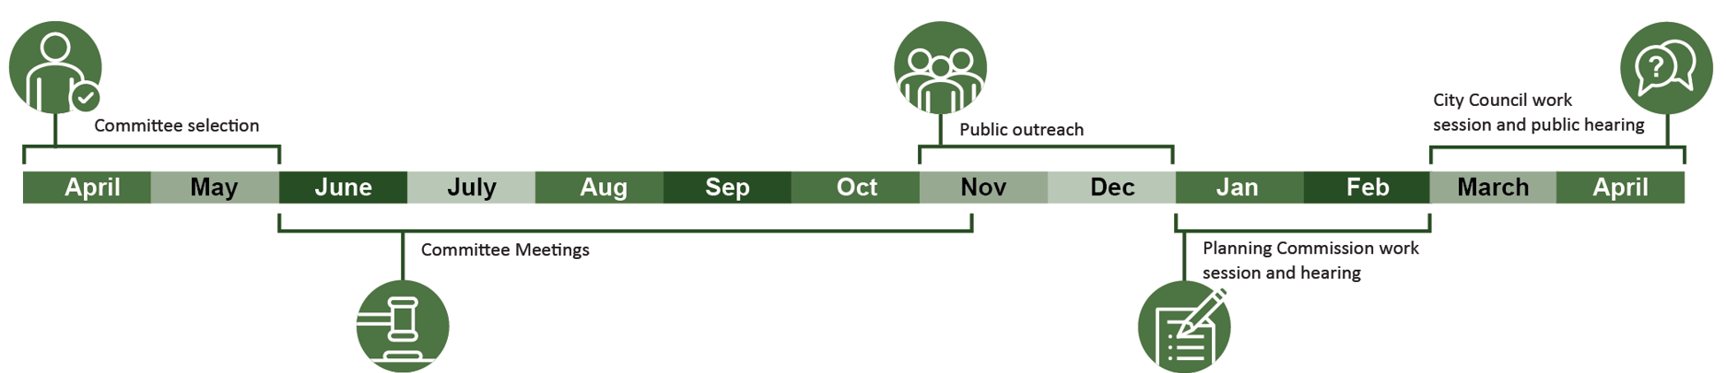
Next Steps
Next Meeting – TBD
Public Outreach – November through December
Planning Commission work session and hearing –January/February
City Council work session and public hearing – 1st Quarter 2024

Slide 18
To obtain this information in an alternate format such as Braille, large print, electronic formats, etc. please contact Isaak Staats at istaats@bendoregon or 541-388-5547; Relay Users Dial 7-1-1.

Slide 19
Replacement Options Summary
Tree replacement ratio regardless of size of tree removed
    1:1 or 1:2
Tree replacement ratio based on tree size removed6" to 10“ - 1:1
    6" to 10“ DBH - 1:1
    10.1" to 14” DBH - 1:2
    Greater than 14" & less than 24“: 1:3
3. Replace with an equal caliper lost
  Example: two 10” caliper trees removed may be mitigated with four 5” caliper trees, five 4” caliper trees, or seven 3” caliper trees.
Notes:
Can option #3 be DBH instead of caliper

Slide 20
On-Site Replacement Options
Tree replacement ratio regardless of size of tree removed
    1:1
    1:2 (every tree removed is replaced with 2)
Tree replacement ratio based on tree size removed6" to 10“ - 1:1
    6" to 10” DBH - 1:1
    10.1" to 14” DBH - 1:2
    Larger than 14": 1:3
    Minimum sizes for replacement trees:
    a. Deciduous tree: 2” caliper measured at four and one-half feet above ground
    b. Coniferous: 6’ height for evergreen trees
Notes:
Can option #3 be DBH instead of caliper

Slide 21
# of Trees (Regulated and Priority)
 | Sky Vista Single-Unit 9.13 Acres | Poplar Cottages 0.54 Acres | Century Mixed-Use 1.50 Acres | Veridian Multi-Unit 2.81 Acres | Caraway Master Plan (Phase 1) 16.81 Acres | Parkside Place Master Plan 37.10 Acres | Bri Multi-Unit 2.23 Acres | Bulletin Multi-Unit 1.57 Acres
# of Trees On-Site
# of Trees On-site | 94 | 45 | 53 | 60 | 264 | 139 | 18 | 27
# of Trees Preserved | 2 | 14 | 0 | 8 | 102 | 17 | 10 | 12
% Preserved | 2.13% | 31.11% | 0.00% | 13.33% | 38.64% | 12.23% | 55.56% | 44.44%
20% | 18.8 | 9 | 10.6 | 12 | 52.8 | 27.8 | 3.6 | 5.4
25% | 23.5 | 11.25 | 13.25 | 15 | 66 | 34.75 | 4.5 | 6.75
30% | 28.2 | 13.5 | 15.9 | 18 | 79.2 | 41.7 | 5.4 | 8.1
5% (Floor) | 4.7 | 2.25 | 2.65 | 3 | 13.2 | 6.95 | 0.9 | 1.35

Slide 22
DBH (Regulated and Priority)
 | Sky Vista Single-Unit 9.13 Acres | Poplar Cottages 0.54 Acres | Century Mixed-Use 1.50 Acres | Veridian Multi-Unit 2.81 Acres | Caraway Master Plan (Phase 1) 16.81 Acres | Parkside Place Master Plan 37.10 Acres | Bri Multi-Unit 2.23 Acres | Bulletin Multi-Unit 1.57 Acres
DBH
Actual On-Site DB | 1739 | 715 | 897 | 968 | 3484 | 2564 | 324 | 362
Actual Preservation | 44 | 207 | 0 | 144 | 1352 | 392 | 233 | 206
% Preserved | 2.53% | 28.95% | 0.00% | 14.88% | 38.81% | 15.29% | 71.91% | 56.91%
20% | 347.8 | 143 | 179.4 | 193.6 | 696.8 | 512.8 | 64.8 | 72.4
25% | 434.75 | 178.75 | 224.25 | 242 | 871 | 641 | 81 | 90.5
30% | 521.7 | 214.5* | 269.1 | 290.4 | 1045.2 | 769.2 | 97.2 | 108.6
0.05% (Floor) | 86.95 | 35.75 | 44.85 | 48.4 | 174.2 | 128.2 | 16.2 | 18.1
* save one more 8” tree

Slide 23
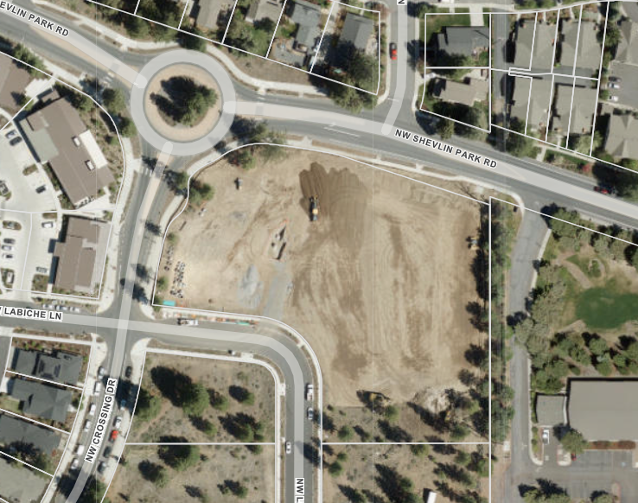
2.74 Acres
Notes:
Based on 6” and 10”

Slide 24
Parkside Place Comparison (37.10 Acres)
Parkside Place | 6" or Larger (All Trees) | 6“ (Deciduous) & 10“ (Coniferous) | 10” or Larger (All Trees)
Total # of Trees On-site | 187 | 139 | 133
Total DBH | 2,902 | 2,564 | 2,529
DBH to be Preserved | 392 | 386 | 378
% to be Preserved | 14% | 15% | 15%
Notes:
Does not affect % of priority trees since they are all 20” or greater
More trees with 6” measure

Slide 25
Bend Bulletin Multi-Unit (1.57 Acres)
Bend Bulletin Multi-Unit | 6" or Larger (All Trees) | 6“ (Deciduous) & 10“ (Coniferous) | 10” or Larger (All Trees)
Total # of Trees On-site | 40 | 27 | 19
Total DBH | 456 | 362 | 312
DBH to be Preserved | 266 | 206 | 200
% to be Preserved | 58% | 57% | 64%

Slide 26
Tree Replacement
DBH - In cases where the 25% DBH is not preserved, the mitigation replacement required to meet the standard is based on the largest tree or trees proposed for removal that equal the required DBH.
Example Veridan
25% DBH: 242
Proposed preservation: 144 (14.88%)
Mitigate: 98 DBH
Trees Proposed for Removal | Trees Removed
Trees 6-10" | 34
Trees 10.1" to 14" | 21
Trees 14.1" + | 20
# Trees | 60
Total DBH | 968

